Slide 1
PRESENTATION
University of Barishal
Name:Akya Mony
Roll:19Che 016
Batch: 066

Slide 2
POLYMER
A polymer is a material made up of many small units called monomers that are chemically bonded together to form large molecules called macromolecules. The word "polymer" comes from the Greek words poly- meaning "many" and -mer meaning "part" or "segment".

Slide 3
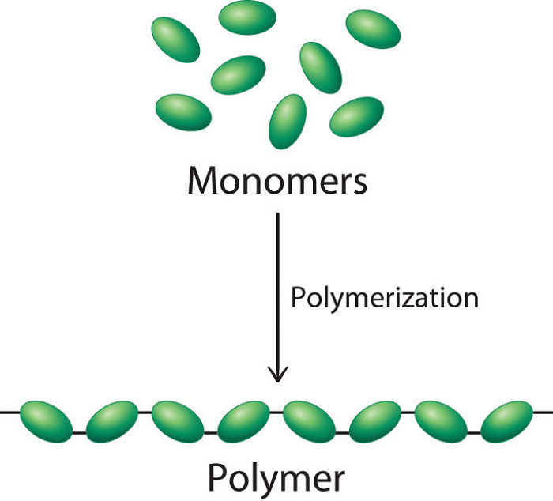
Basic of Polymer:
This Photo by Unknown Author is licensed under CC BY-NC-ND

Slide 4
Here are some examples of polymers:
Natural polymers: These are substances that occur naturally in plants and animals, and can be inorganic or organic. Examples include cellulose, rubber, silk, DNA, proteins, and wool.
Synthetic polymers: These are polymers that humans create artificially in a lab. Examples include:
Polyvinyl chloride (PVC): A common polymer used in electrical insulation and cabling, and for coating textiles. PVC is a linear polymer, meaning it has a long and straight chain structure.
Polyethylene: A synthetic polymer made up of a long chain of ethylene molecules. The long chain creates strong intermolecular forces, making polyethylene a strong, durable, and flexible solid.
Polystyrene (PS): A popular plastic used in disposable cutlery, plastic models, CD and DVD cases, and smoke detector housings. PS is an aromatic polymer made from the monomer styrene.
Nylon: A polyamide polymer with amide groups in the main polymer chain. Nylon 6 and nylon 6,6 are two types of nylon used in tires.
Teflon: A synthetic polymer commonly used in cookware.
Polymers are made up of many monomers, or small repeating units, that are bonded together to form a chain of atoms. When polymers are very large, they are called macromolecules.

Slide 5
Examples of polymer:
Examples of synthetic polymers include nylon, polyethylene, polyester, Teflon, and epoxy. Natural polymers occur in nature and can be extracted. They are often water-based. Examples of naturally occurring polymers are silk, wool, DNA, cellulose and proteins.

Slide 6
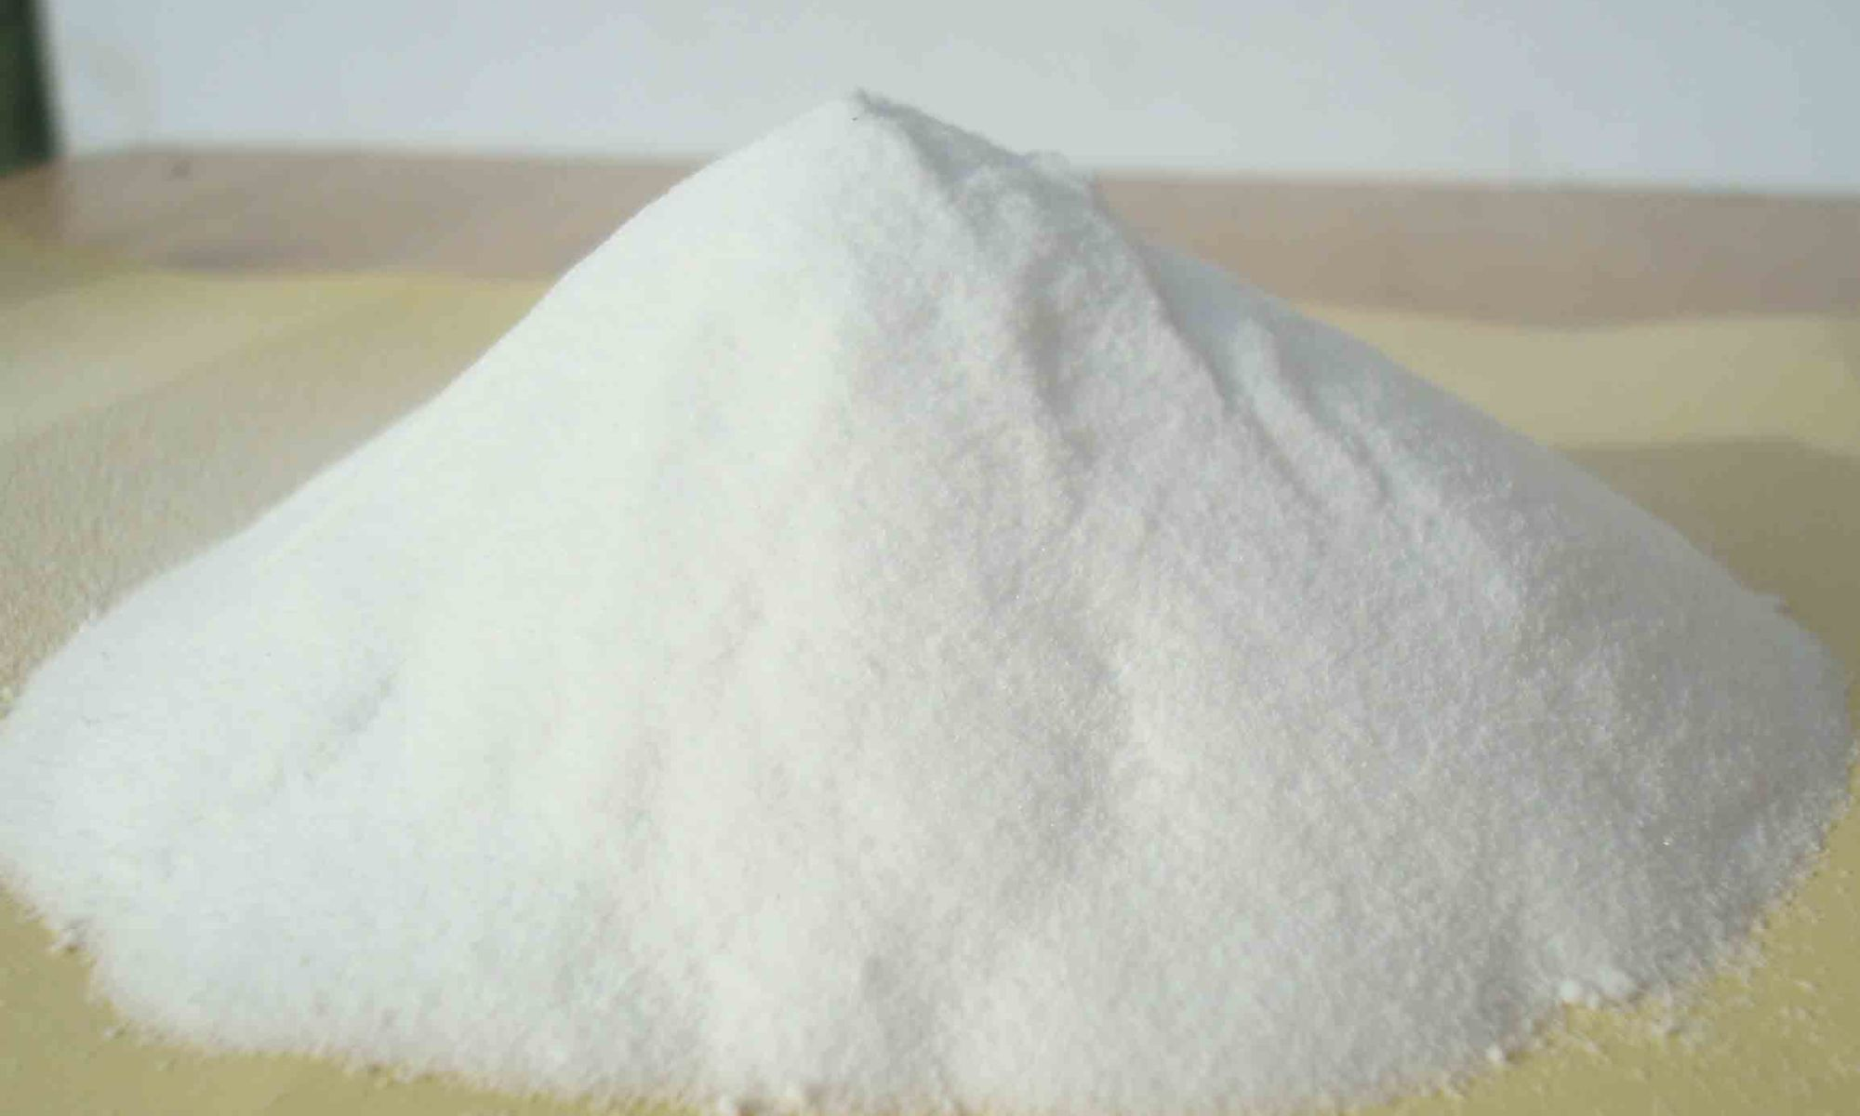
Pictures of some polymer and their structure:
This Photo by Unknown Author is licensed under CC BY-NC-ND
FIGURE: PVA

Slide 7
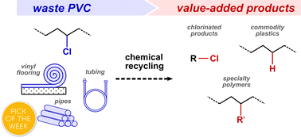
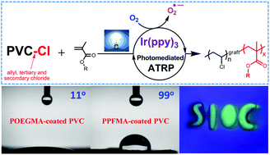
Preparation of poly vinylchloride:
This Photo by Unknown Author is licensed under CC BY-NC
This Photo by Unknown Author is licensed under CC BY

Slide 8


Slide 10
THANK YOU

